Slide 1
Cooperative Memory Management Avoiding Paging and Improving Performance
Emery Berger
University of Massachusetts Amherst
TexPoint fonts used in EMF.
Read the TexPoint manual before you delete this box.: AAAAAAA

Slide 2
Garbage Collection Performance
Garbage collection now performs reasonably well
High throughput
Low pause times
Given large heap and sufficient memory
But: what happens when there’s not enough RAM?

Slide 3
GC Performance While Paging
RAM
Hard Disk
Heap: most pages in RAM, one on disk GC begins

Slide 4
GC Performance While Paging
RAM
Hard Disk
Collector touches an evicted page...

Slide 5
GC Performance While Paging
RAM
Hard Disk
... bringing the page into memory ...

Slide 6
GC Performance While Paging
RAM
Hard Disk
... but triggers another page eviction.

Slide 7
GC Performance While Paging
RAM
Hard Disk
... but triggers another page eviction.

Slide 8
GC Performance While Paging
RAM
Hard Disk
Collector touches newly-evicted page...

Slide 9
GC Performance While Paging
RAM
Hard Disk
Collector touches newly-evicted page...

Slide 10
GC Performance While Paging
RAM
Hard Disk
... leading to the eviction of yet another page…

Slide 11
GC Performance While Paging
RAM
Hard Disk
… which eventually triggers more paging.

Slide 12
Program Throughput
Paging: 40X to 62X increase in runtime

Slide 13
The problem
Garbage collector: VM-oblivious
Examines all reachable objects
Lacks knowledge of page residency
Treats evicted and resident pages identically
Virtual memory: GC-oblivious
GC & application have different access patterns
Likely to evict pages needed by GC

Slide 14
Cooperative Memory Management
Avoid paging via cooperation between the GC and the VMM
“I’m a cooperative
application”
Garbage collector
Virtual memory manager
CRAMM
Coarse-grained
change in memory pressure
Adjusts heap size
Tracks per-process & global memory utilization
new heap size
Fine-grained
page eviction notification
Bookmarking collection
Evacuates pages
Selects victim pages
Page replacement
victim page(s)

Slide 15
CRAMM
Cooperative Robust Automatic Memory Management

Slide 16
Heap Size Matters
GC languages
Java, C#, Python, Ruby, etc.
Increasingly popular
Heap size critical
Too large:
Paging (10-100x slower)
Too small:
Excessive # collections hurts throughput
JVM
Heap Size (120MB)
Memory (100MB)
VM/OS
Disk
Heap Size (60MB)
Memory (100MB)

Slide 17
What is the right heap size?
Find the sweet spot:
Large enough to minimize collections
Small enough to avoid paging
BUT: sweet spot changes constantly (multiprogramming)
CRAMM: Cooperative Robust Automatic Memory Management
Goal: via cooperation with OS & GC, keep garbage-collected applications running at their sweet spot

Slide 18
CRAMM Overview
Cooperative approach:
Collector-neutral heap sizing model (GC)
suitable for broad range of collectors
Statistics-gathering VM (OS)
Automatically resizes heap in response to memory pressure
Grows to maximize space utilization
Shrinks to eliminate paging
Improves performance by up to 20x
Overhead on non-GC apps: 1-2.5%

Slide 19
GC: How do we choose a good heap size?

Slide 20

GC: Collector-neutral model
heapUtilFactor: constant dependent on GC algorithm
Fixed overhead:
Libraries, codes, copying (app’s live size)
SemiSpace (copying)
a ≈ ½
b ≈ JVM, code + app’s live size

Slide 21
GC: a collector-neutral WSS model
heapUtilFactor: constant dependent on GC algorithm
Fixed overhead:
Libraries, codes, copying (app’s live size)
SemiSpace (copying)
MS (non-copying)
a ≈ ½
a ≈ 1
b ≈ JVM, code + app’s live size
b ≈ JVM, code

Slide 22




GC: Selecting new heap size
Set heap size so that working set just fits in current available memory
GC: heapUtilFactor (a) & cur_heapSize
VMM: WSS & available memory

Slide 23
VM: How do we collect information to support heap size selection? (with low overhead) WSS, Available Memory

Slide 24

Calculating WSS w.r.t 5%
Memory reference sequence
m
n
c
l
k
a
m
n
l
b
k
m
n
c
l
m
n
d
e
c
n
f
g
h
i
j
k
l
m
n
c
k
l
m
n
b
d
c
e
d
f
e
g
f
h
g
i
h
j
i
k
j
l
k
m
l
m
n
c
n
k
c
l
k
m
l
m
n
n
LRU Queue
Pages in Least Recently Used order
m
b
a
n
l
k
c
n
m
m
a
k
c
n
l
m
l
c
n
l
k
m
k
n
l
k
c
m
c
j
n
l
k
j
j
j
j
i
j
i
i
i
i
h
i
h
h
h
h
g
h
g
g
g
g
f
g
f
f
f
f
e
f
e
e
e
e
d
e
c
d
d
d
d
d
b
b
b
b
b
b
a
a
a
a
a
a
1
14
0
0
0
0
4
Hit Histogram
3
2
1
0
0
0
0
0
0
0
1
0
0
0
Associated with each LRU position
5
faults
Fault Curve
1
1
4
11
14
pages

Slide 25
Computing hit histogram
Not possible in standard VM:
Global LRU queues
No per process/file information or control
Difficult to estimate app’s WSS / available memory
CRAMM VM:
Per process/file page management:
Page list: Active, Inactive, Evicted
Add & maintain histogram

Slide 26
Managing pages for a process
Pages protected by turning off permissions (minor fault)
Pages evicted to disk. (major fault)
Active (CLOCK)
Inactive (LRU)
Evicted (LRU)
Major fault
Header
Refill & Adjustment
Evicted
Page Des
AVL node
Minor fault
faults
Histogram
Pages

Slide 27
Controlling overhead
Pages protected by turning off permissions (minor fault)
Pages evicted to disk. (major fault)
Active (CLOCK)
Inactive (LRU)
Evicted (LRU)
Header
Page Des
AVL node
Buffer
faults
control the boundary: 1% of execution time
Histogram
Pages

Slide 28
Experimental Evaluation
Experimental setup:
CRAMM (Jikes RVM + Linux), unmodified Jikes RVM, JRockit, HotSpot
GC: GenCopy, CopyMS, MS, SemiSpace, GenMS
SPECjvm98, DaCapo, SPECjbb, ipsixql + SPEC2000
Experiments:
Dynamic memory pressure
Overhead w/o memory pressure

Slide 29
Dynamic Memory Pressure (1)
GenMS – SPECjbb (Modified) w/ 160M memory
stock w/o pressure
296.67 secs 1136 majflts
CRAMM w/ pressure 302.53 secs 1613 majflts 98% CPU
Stock w/ pressure 720.11 secs 39944 majflts 48% CPU
# transactions finished (thousands)
Initial heap size: 120MB
stock w/o pressure
CRAMM w/ pressure
Stock w/ pressure
Elapsed Time (seconds)

Slide 30
Dynamic Memory Pressure (2)
HotSpot
# transactions finished (thousands)
JRockit
CRAMM-GenMS
CRAMM-MS
CRAMM-SS
HotSpot
JRockit
SPECjbb (modified): Normalized Elapsed Time

Slide 31
CRAMM VM: Efficiency
CRAMM VM Overhead
4
Additional Overhead
3.5
Histogram Collection
3
2.5
% Overhead
2
1.5
1
0.5
0
SPEC2Kint
SPEC2Kfp
Java-
Java-
Java-
Java-GenMS
Java-
GenCopy
SemiSpace
MarkSweep
CopyMS
Overhead: on average, 1% - 2.5%

Slide 32
CRAMM Conclusion
Cooperative Robust Automatic Memory Management (CRAMM)
GC: Collector-neutral WSS model
VM: Statistics-gathering virtual memory manager
Dynamically chooses nearly-optimal heap size for garbage-collected applications
Maximizes use of memory without paging
Minimal overhead (1% - 2.5%)
Quickly adapts to memory pressure changes
But – what if heap cannot fit in memory?

Slide 33
Bookmarking Collection
Bookmarking Collection

Slide 34
Bookmarking Garbage Collection
Bookmarking collector
Extended virtual memory manager
Select victim(s)
Update residency
page eviction notification
Page replacement
victim page(s)
In response to notifications, BC:
Adjusts heap size to fit in main memory
Prevents eviction of important pages
Avoids touching non-resident pages

Slide 35
Avoiding Page Evictions
0
0
0
0
0
RAM
Hard Disk
When notified, avoid a pending eviction…

Slide 36
Avoiding Page Evictions
0
0
0
0
0
RAM
Hard Disk
…find a page BC knows to be empty…

Slide 37
Avoiding Page Evictions
0
0
0
0
0
RAM
Hard Disk
… and discard it…

Slide 38
Avoiding Page Evictions
0
0
0
0
RAM
Hard Disk
… eliminating the need to evict a page.

Slide 39
Limit of Heap Sizing
Could collect, compact, compress, etc.
Eventually:
Will run out of pages to discard
Going to have to evict non-empty pages
Result: Paging
Can we avoid this?

Slide 40
Bookmarks
We introduce bookmarks:
Summaries of connectivity info on evicted pages
References from objects on the page
These summaries enable GC w/o paging

Slide 41
Bookmarking
0
0
0
0
RAM
Hard Disk
Process page before eviction…

Slide 42
Bookmarking
0
0
0
0
B
B
RAM
Hard Disk
... by following pointers & bookmark-ing targets...

Slide 43
Bookmarking
0
0
1
0
0
B
B
RAM
Hard Disk
... increment the referring page count...

Slide 44
Bookmarking
0
0
1
0
B
B
B
B
B
B
B
RAM
Hard Disk
... conservatively bookmark objects on the page...

Slide 45
Bookmarking
0
1
0
0
B
B
RAM
0
B
B
B
B
B
Hard Disk
... then tell extended VM to evict the page.

Slide 46
Bookmarking Details
Cheap summary of connectivity
One bit per object: free
One word per page: referring page count
Bookmarks cleared when count = zero
Use bookmarks as secondary roots during garbage collection

Slide 47
Collection with Bookmarks
roots
0
1
0
B
B
RAM
0
B
B
B
B
B
Hard Disk
Process objects as usual, but...

Slide 48
Collection with Bookmarks
roots
0
1
0
B
B
RAM
0
B
B
B
B
B
Hard Disk
... ignore any references to evicted pages.

Slide 49
Collection with Bookmarks
roots
0
1
0
B
B
RAM
0
B
B
B
B
B
Hard Disk
Use bookmarks to recreate evicted references...

Slide 50
Collection with Bookmarks
roots
0
1
0
B
B
RAM
0
B
B
B
B
B
Hard Disk
... and continue collection.

Slide 51
Collection with Bookmarks
roots
0
1
0
B
B
RAM
0
B
B
B
B
B
Hard Disk
Result: Garbage collection without paging

Slide 52
Collection with Bookmarks
roots
0
1
0
B
B
RAM
0
B
B
B
B
B
Hard Disk
Note: can waste space on evicted pages.

Slide 53
Bookmarking Incompleteness
Space waste not just on evicted pages
Collection with bookmarks is necessarily incomplete
Not guaranteed to reclaim all memory

Slide 54
Bookmarking Incompleteness
0
1
0
B
B
RAM
0
B
B
B
B
B
Hard Disk
When a reference to an evicted object changes…

Slide 55
Bookmarking Incompleteness
0
1
0
B
B
RAM
0
B
B
B
B
B
Hard Disk
When a reference to an evicted object changes…

Slide 56
Bookmarking Incompleteness
0
1
0
B
B
RAM
0
B
B
B
B
B
Hard Disk
…it can make evicted objects unreachable.

Slide 57
Bookmarking Incompleteness
0
1
0
B
B
RAM
0
B
B
B
B
B
Hard Disk
But bookmarks cannot be removed…

Slide 58
Bookmarking Incompleteness
0
1
0
B
B
RAM
0
B
B
B
B
B
Hard Disk
…retaining unreachable heap objects.

Slide 59
Bookmarking Completeness
Worst-case: completeness requires duplicating evicted pages
See paper for more info
How can we preserve completeness?

Slide 60
Bookmarking Completeness
0
1
0
B
B
RAM
0
B
B
B
B
B
Hard Disk
If the heap becomes full…

Slide 61
Bookmarking Completeness
0
0
0
RAM
0
Hard Disk
…BC removes all bookmarks…

Slide 62
Bookmarking Completeness
0
0
0
???
0
???
…and performs a VM-oblivious collection...

Slide 63
Bookmarking Completeness
0
0
0
???
0
???
…reclaiming all unreachable objects.

Slide 64
Bookmarking Completeness
0
0
0
BC’s worst case = other collectors’ common case
???
0
???
…reclaiming all unreachable objects.

Slide 65
BC Performance Optimizations
Uses generational design similar to GenMS
Yields good performance when not paging
Compacts heap to reduce pressure
Prevents single object from tying down a page

Slide 66
Experimental Methodology
Extended Linux kernel 2.4.20
Eviction notification
vm_relinquish()
Added only 600 LOC
Jikes RVM 2.3.2 & MMTk
Compare BC to MarkSweep, SemiSpace, CopyMS, GenCopy, GenMS

Slide 67
Throughput w/o Memory Pressure
BC runtime comparable to GenMS

Slide 68
Throughput while Paging
BC throughput closely follows ideal curve

Slide 69
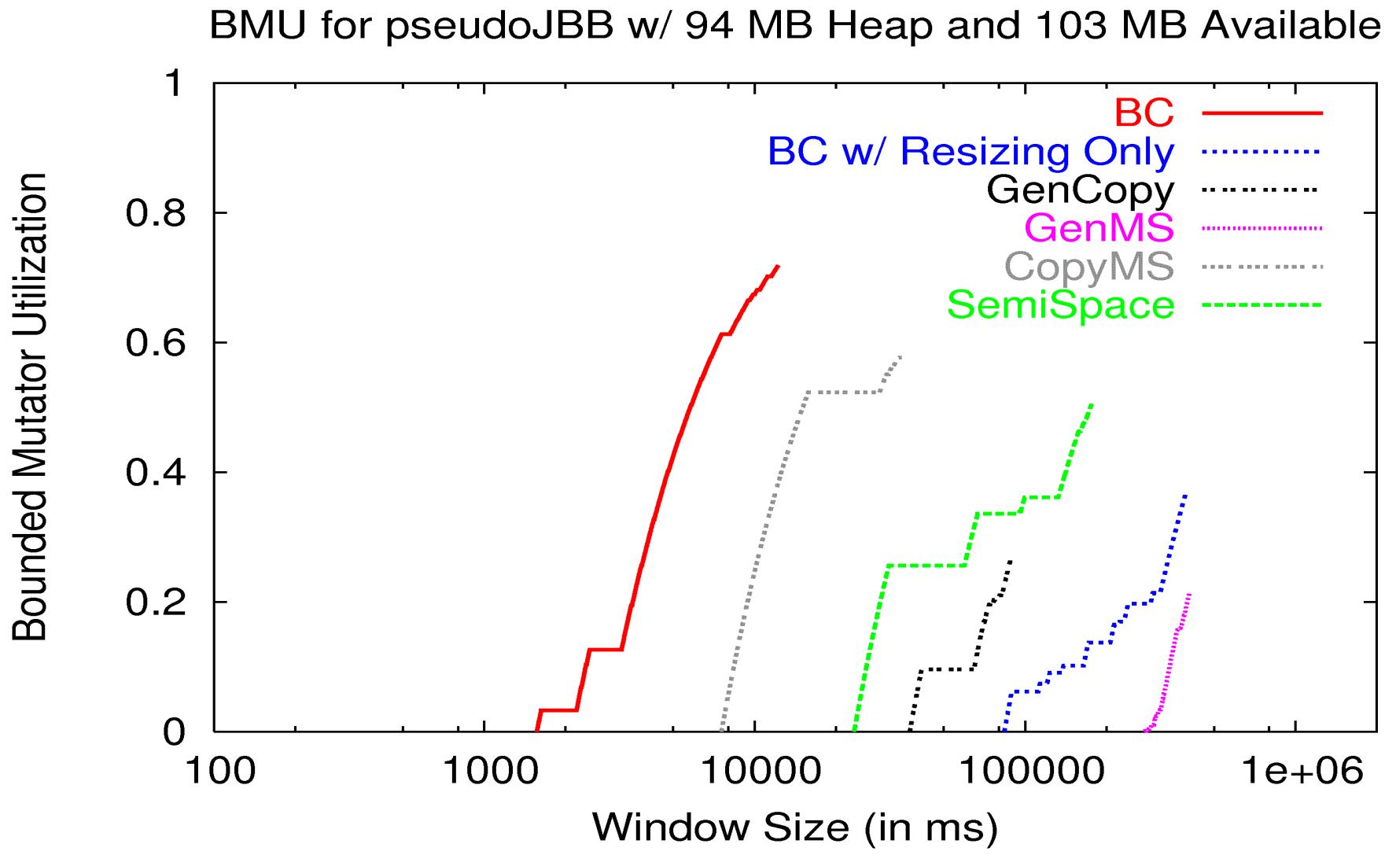
BMU Curve w/ Memory Pressure
71.9%
12231 ms
39.1%
467944 ms
0.0%
1566 ms
0.0%
81591 ms
Bookmarking crucial for good performance

Slide 70
Summary of Results
When not paging:
BC as fast as GenMS
When paging:
vs. GenMS (fastest when not paging)
41x faster, avg pause up to 218x smaller
vs. CopyMS (next fastest when paging)
5x faster, avg pause up to 45x smaller

Slide 71
The End
www.cs.umass.edu/~emery

Slide 72
Calculating available memory
What’s “available”?
Page cache
Are pages from closed files “free”?
Policy decision: yes
Easy to distinguish in CRAMM – on separate list
Available Memory = resident application pages + free pages in the system + pages from closed files

